Slide 1
1 - List Data Structure
Data Structures and Algorithms in Java
<number>/23

Slide 2
Objectives
List and self-referential structures
Types of linked lists:
- Singly Linked Lists
- Circular Lists
- Doubly Linked Lists
Lists in java.util
Data Structures and Algorithms in Java
<number>/23

Slide 3
List Data Structures
List: sequence of items of a given base type, items can be added, deleted, and retrieved from any position.
A list as a dynamic array to avoid imposing a maximum size.
The items are stored in nodes that are linked together with pointers.
The possible values of this type are sequences of items of type BaseType
Data Structures and Algorithms in Java
<number>/23
Notes:
RMIT Vietnam
COSC2082 - Programming 2

Slide 4
Drawbacks of Arrays
Array has some important limitations:
  require size information for creation
  Inserting and deleting an element need to moving other elements around
Other data structures are more efficient in such situations.
Data Structures and Algorithms in Java
<number>/23

Slide 5
Self-Referential Structures
Many dynamic data structures are implemented through the use of a self-referential structure.
A self-referential structure is an object, one of whose elements is a reference to another object of its own type.
Employee
String name;
int age;
Linked lists
trees
DataNode
DataNode
Employee info;
DataNode next;
Employee info;
DataNode left;
DataNode right;
Self-Referential Structures
Data Structures and Algorithms in Java
<number>/23
Notes:
RMIT Vietnam
COSC2082 - Programming 2

Slide 6
Linked Lists
Linked structure: is a collection of nodes storing data and links to other nodes
Linked list: is a linear data structure composed of nodes, each node holding some information and a reference to another node in the list
Types of linked lists
  - Singly and Doubly Linked List
Data Structures and Algorithms in Java
<number>/23

Slide 7

Singly Linked Lists
Singly linked list: is a list whose node includes two data fields: info and next.
The info field: store information
The next field: link to its successor in this sequence
head
tail
Singly Linked List
Data Structures and Algorithms in Java
<number>/23

Slide 8

Singly Linked List Implementation
class Node
{int info;
Node next;
Node() {}
Node(int x, Node p)
{info=x;next=p;
}
}
class MyList
{Node head,tail;
MyList() {head=tail=null;}
boolean isEmpty()
{return(head==null);
}
void clear()
{head=tail=null;
}
void add(int x) {
Node q = new Node (x);
if(isEmpty())
head=tail=null;
else{
tail.next=q;
tail=q;
}
}
void traverse()
{Node p=head;
while(p!=null)
{System.out.print(" " + p.info);
p=p.next;
}
System.out.println();
}
Node search(int x) {...}
void dele(int x) {...}
}
Data Structures and Algorithms in Java
<number>/23

Slide 9

Singly Linked Lists - 1
Add First
Inserting a new node at the beginning of a Singly Linked List
If (isEmpty()) { head = tail = node;}
Else
{node. next = head;
head = node; }
size++;
Data Structures and Algorithms in Java
<number>/23
Notes:
Image source: Drozdek

Slide 10
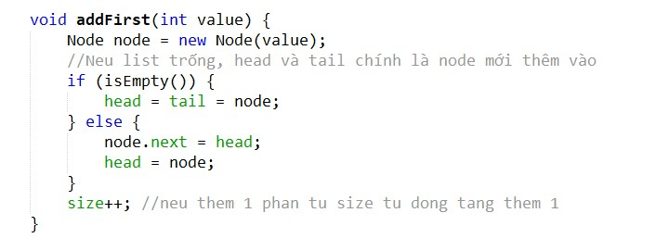
Data Structures and Algorithms in Java
<number>/23

Slide 11

Singly Linked Lists - 2
Add Last
Inserting a new node at the end of a Singly Linked List
If(isEmpty()) {
head = tail = node;}
Else {tail.next = node;
node = head; }
size++;
Data Structures and Algorithms in Java
<number>/23

Slide 12
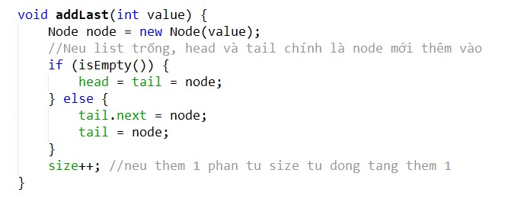
Data Structures and Algorithms in Java
<number>/23

Slide 13
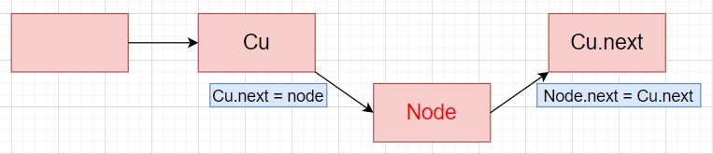
Singly Linked Lists - 3
Add Index
Inserting a new node following the index of a Singly Linked List
node.next = cu.next;
cu.next = node;
size++;
Data Structures and Algorithms in Java
<number>/23
Notes:
Image source: Drozdek

Slide 14
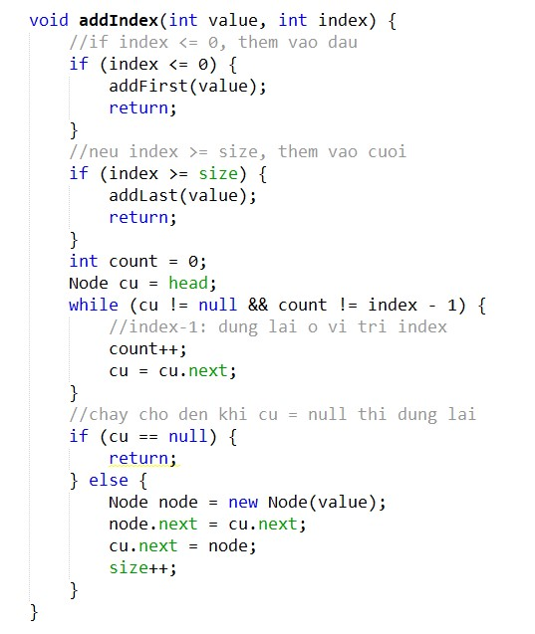
Data Structures and Algorithms in Java
<number>/23

Slide 15

Singly Linked Lists - 4
Delete First
Deleting a node from the beginning of a Singly Linked List
If(isEmpty())
return;
head = head.next;
size--;
Data Structures and Algorithms in Java
<number>/23

Slide 16
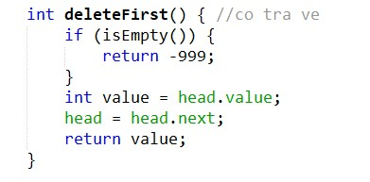
Data Structures and Algorithms in Java
<number>/23

Slide 17
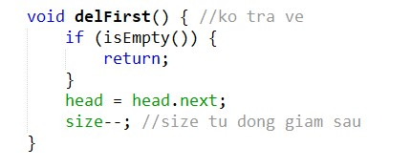
Data Structures and Algorithms in Java
<number>/23

Slide 18

Singly Linked List - 5
Delete Last
Deleting a node from the end of a Singly Linked List
cu.next = null;
tail = cu;
size--;
Data Structures and Algorithms in Java
<number>/23

Slide 19
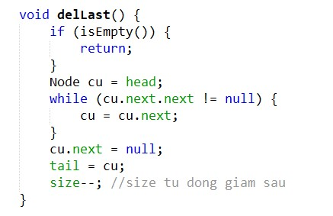
Data Structures and Algorithms in Java
<number>/23

Slide 20
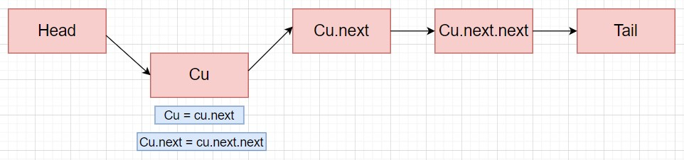
Singly Linked List - 6
Delete Index
Deleting a node following the index of a Singly Linked List
cu = cu.next;
cu.next = cu.next.next;
size--;
Data Structures and Algorithms in Java
<number>/23

Slide 21
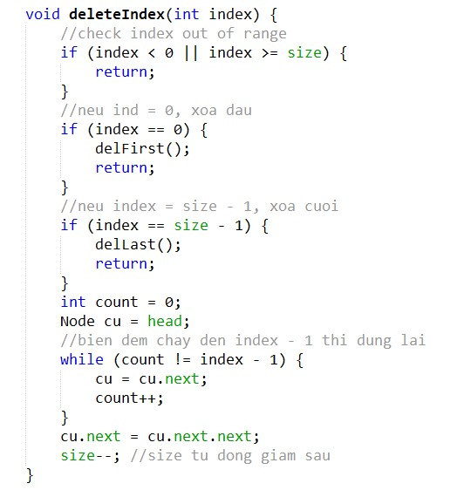
Data Structures and Algorithms in Java
<number>/23

Slide 22

Circular Lists
circular list : when nodes form a ring-The list is finite and each node has a successor
Circular SIngly Linked List
Data Structures and Algorithms in Java
<number>/23

Slide 23

Circular Lists - 2
Inserting nodes
Data Structures and Algorithms in Java
<number>/23
Inserting nodes at the front of a circular singly linked list (a) and at its end (b)

Slide 24
Circular List application
Round-Robin Scheduling
- It is method used in CPU
- A process is given a short turn to execute (time slice), but it is interrupted when the slice ends. Each active process is given its own time slice, taking turns in a cyclic order.
2. Using circular linked list to implement Round-Robin Scheduling
- rotate( ): Moves the first element to the end of the list. Round-robin scheduling can be by repeatedly performing the following steps on a circularly linked list C:
1. Give a time slice to process C.first( )
2. C.rotate( )
Data Structures and Algorithms in Java
<number>/23

Slide 25

Doubly Linked Lists - 1
In a doubly linked list, each node has two reference fields, one to the successor and one to the predecessor
class MyList
{Node head,tail;
MyList() { head=tail=null; }
boolean isEmpty(){
return(head==null); }
void clear() {head=tail=null;}
void add(int x){
Node q = new Node(x);
if(isEmpty())
head=tail=null;
else{
tail.next=q;
tail=q;
}
}
}
Doubly Linked List
class Node
{int info;
Node prev,next;
Node() {}
Node(int x, Node p, Node q)
{info=x;prev=p; next=q;
}
}
Data Structures and Algorithms in Java
<number>/23
Notes:
Image Source: Drozdek

Slide 26
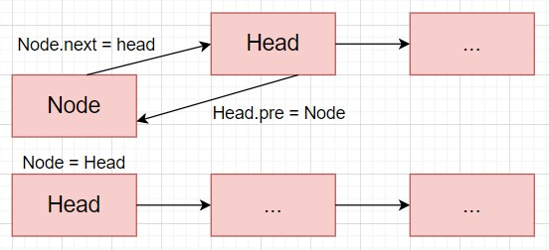
Doubly Linked Lists - 2
Add First
Adding new node at the beginning of Doubly Linked List
node.next = head
head.pre = node
head = node
size++;
Data Structures and Algorithms in Java
<number>/23

Slide 27
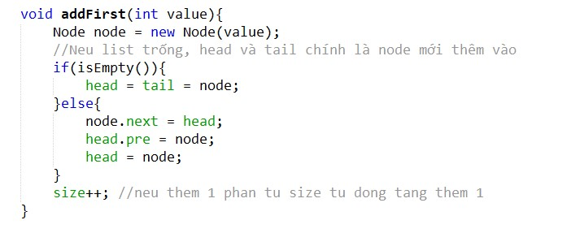
Data Structures and Algorithms in Java
<number>/23

Slide 28


Doubly Linked Lists - 3
Add Last
Adding new node at the end of Doubly Linked List
tail.next = node;
node.pre = tail;
tail = node;
size++;
Data Structures and Algorithms in Java
<number>/23

Slide 29
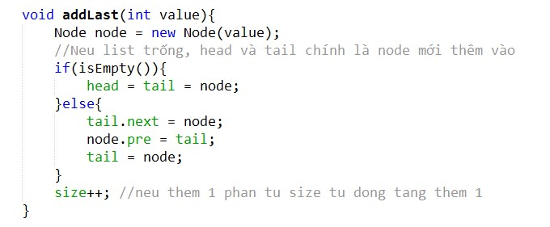
Data Structures and Algorithms in Java
<number>/23

Slide 30
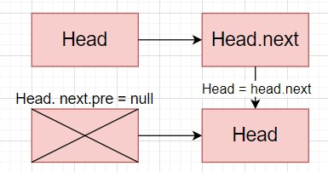
Doubly Linked Lists - 4
Delete First
Deleting a node from the beginning of Doubly Linked List
head.next.pre = null;
head =head.next;
size--;
Data Structures and Algorithms in Java
<number>/23

Slide 31
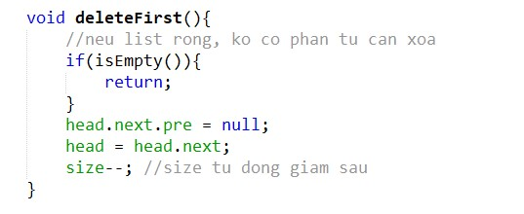
Data Structures and Algorithms in Java
<number>/23

Slide 32

Doubly Linked Lists - 5
Delete Last
Deleting a node from the end of Doubly Linked List
tail.pre.next = null;
tail = tail.pre;
size--;
Data Structures and Algorithms in Java
<number>/23

Slide 33
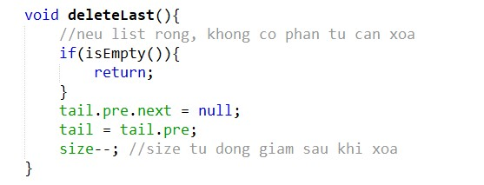
Data Structures and Algorithms in Java
<number>/23

Slide 34
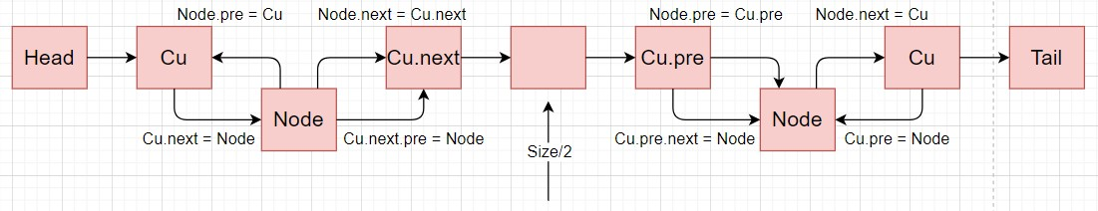
Doubly Linked Lists - 6
Add Index
Add a new node following the Index of Doubly Linked List
- Neu chay tu nua dau:
if(index < size/2){
//dat cu o truoc vi tri can add
node.next = cu.next;
cu.next.pre = node;
node.pre = cu;
cu.next = node;}
Neu chay tu nua cuoi:
if(index > size/2){
//dat cu o sau vi tri can add
node.pre = cu.pre;
cu.pre.next = node;
node.next = cu;
cu.pre = node;}
Data Structures and Algorithms in Java
<number>/23

Slide 35
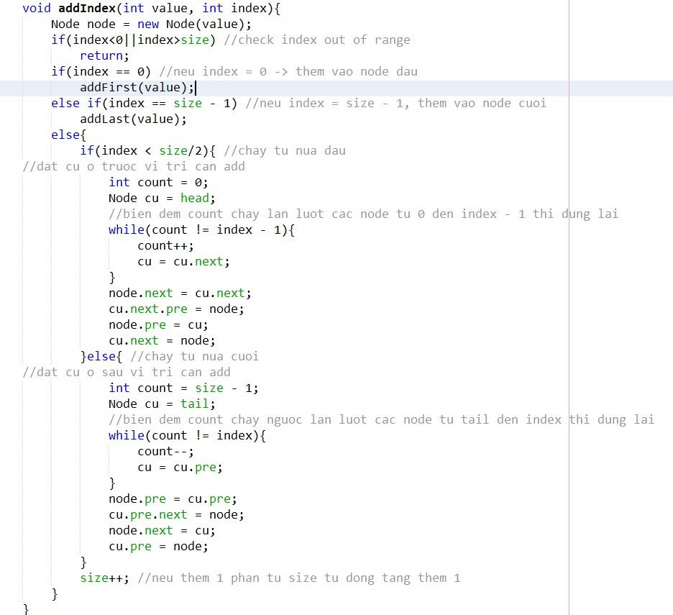
Data Structures and Algorithms in Java
<number>/23

Slide 36
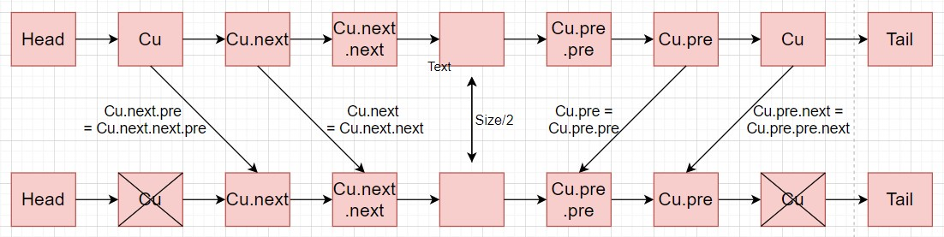
Doubly Linked Lists -7
Delete Index
Deleting a node following the index of Doubly Linked List
- Neu chay tu nua dau:
if(index < size/2){
cu.next.next.pre = cu.next.pre;
cu.next = cu.next.next;}
- Neu chay tu nua cuoi:
if(index > size/2){
cu.pre.pre.next = cu.pre.next;
cu.pre = cu.pre.pre;}
Data Structures and Algorithms in Java
<number>/23

Slide 37
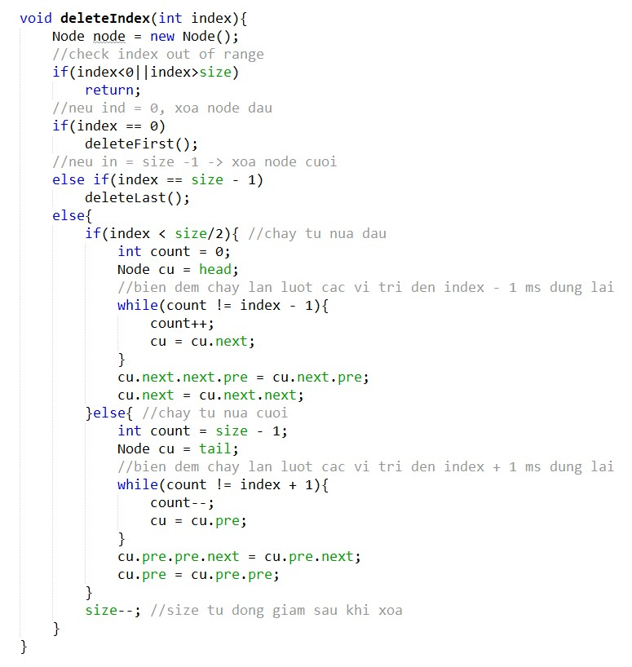
Data Structures and Algorithms in Java
<number>/23

Slide 38
Lists in java.util - LinkedList class
boolean | add(E o) Appends the specified element to the end of this list.
void | addFirst(E o) Inserts the given element at the beginning of this list.
void | addLast(E o) Appends the given element to the end of this list.
void | clear() Removes all of the elements from this list.
E | get(int index) Returns the element at the specified position in this list.
E | getFirst() Returns the first element in this list.
E | getLast() Returns the last element in this list.
E | remove(int index) Removes the element at the specified position in this list.
E | removeFirst()Removes and returns the first element from this list.
E | removeLast() Removes and returns the last element from this list.
int | size() Returns the number of elements in this list.
Object[] | toArray() Returns an array containing all of the elements in this list in the correct order.
Data Structures and Algorithms in Java
<number>/23

Slide 39
Lists in java.util - ArrayList class
boolean | add(E o) Appends the specified element to the end of this list.
void | add(int index, E o) Inserts the given element at the specified pos.
void | clear() Removes all of the elements from this list.
E | get(int index) Returns the element at the specified position in this list.
E | remove(int index) Removes the element at the specified position in this list.
int | size() Returns the number of elements in this list.
void | ensureCapacity(int minCapacity) Increases the capacity of this ArrayList instance, if necessary, to ensure that it can hold at least the number of elements specified by the minimum capacity argument.
void | trimToSize() Trims the capacity of this ArrayList instance to be the list's current size.
Object[] | toArray() Returns an array containing all of the elements in this list in the correct order.
Data Structures and Algorithms in Java
<number>/23

Slide 40
Summary
A list is a sequence of items of a given base type.
A list as a dynamic array to avoid imposing a maximum size.
Linked list , the items are stored in nodes, linked together with pointers.
A singly linked list is when a node has a link to its successor (next node) only.
A circular list is when nodes form a ring: The list is finite and each node has a successor.
A doubly linked list is when a node has links to its previous and next nodes.
Data Structures and Algorithms in Java
<number>/23

